Slide 1

Fifth European Forum on Social Entrepreneurship, Plovdiv, 31 March 2016
Social Entrepreneurship – innovative model of social inclusion and employment
The CECOP policy concerning the labour integration of disadvantaged persons
Bruno Roelants
31 MARCH 2016

Slide 2
The European confederation of industrial and service cooperatives
31 MARCH 2016

Slide 3


50 000 enterprises with 1.4 million workers
In 16 EU countries
10 000 are social cooperatives
with 400 000 workers
5000 are work integration social cooperatives
employing around 40 000 disadvantaged workers
31 March 2016
www.cecop.coop

Slide 4
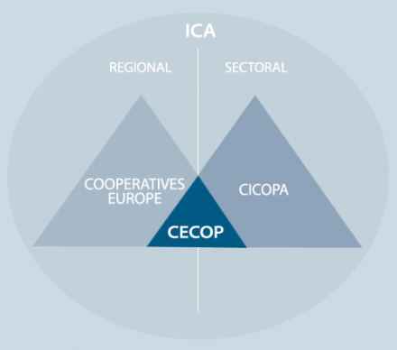
50 000 enterprises with 1.4 million workers
In 16 EU countries
10 000 are social cooperatives
With around 300 000 workers
5000 are work integration social cooperatives
30 000 disadvantaged workers
31 March 2016
www.cecop.coop

Slide 5

18 March 2016
www.cecop.coop

Slide 6
Cooperatives provide over 250 million jobs or economic activities in the world
12% of employment in the G20
31 March 2016
www.cecop.coop

Slide 7
Who are disadvantaged people?
Disabled
Socially disadvantaged
31 March 2016
www.cecop.coop

Slide 8

Social economy, social cooperatives, social enterprise
Social economy
Cooperatives
Social enterprises
Social cooperatives
www.cecop.coop

Slide 9
Social economy’s definition in European Parliament’s 2009 resolution:
It includes “cooperatives, mutual societies, associations, social enterprises and organisations, foundations and other entities” (preamble, H)
It « has demonstrated that it can greatly improve the social status of disadvantaged people” (preamble, E)
31 March 2016
www.cecop.coop

Slide 10
Recognition of the social economy by the European Council:
Council Conclusions on "The promotion of the social economy as a key driver of economic and social development in Europe” (December 2015)
31 March 2016
www.cecop.coop

Slide 11
Recognition of the social economy by the European Economic and Social Committee
31 March 2016
www.cecop.coop

Slide 12
Definition of social enterprises according to the European Commission
According to the Social Business Initiative, « social enterprises » are :
« - Those for whom the social/societal objective of the common good is the reason for the commercial activity.
- Those where profits are mainly re-invested with a view to achieving the social objective.
- And where the method of organisation and ownership system reflects their mission, using democratic or participatory principles or focusing on social justice”
31 March 2016
www.cecop.coop

Slide 13

What is a social cooperative?
World Social Cooperative Standards
“Social cooperatives explicitly define a general interest mission as their primary purpose and carry out this mission directly in the production of goods and services of general interest”.
Work integration is a service of general interest
31 March 2016
www.cecop.coop

Slide 14
EU Public procurement directive (for EU level tenders)
Reserved markets
Art. 20. Member States may reserve the right to participate in public procurement procedures to sheltered workshops and economic operators whose main aim is the social and professional integration of disabled or disadvantaged persons or may provide for such contracts to be performed in the context of sheltered employment programmes, provided that at least 30 % of the employees of those workshops, economic operators or programmes are disabled or disadvantaged workers.
31 March 2016
www.cecop.coop

Slide 15
Disadvantaged workers should :
Be provided full and stable employment, with all labour rights
Be helped to be socially re-integrated
31 March 2016
www.cecop.coop

Slide 16


More information: www.cecop.coop
Follow us:

